Slide 1
GPRO EXAM
FEEL FREE TO ASK QUESTIONS DURING THE PRESENTATION

Slide 2
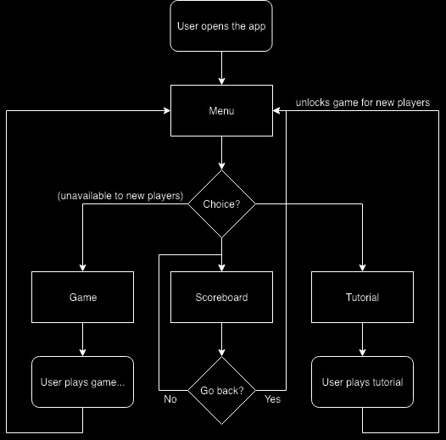
FLOW CHART

Slide 3
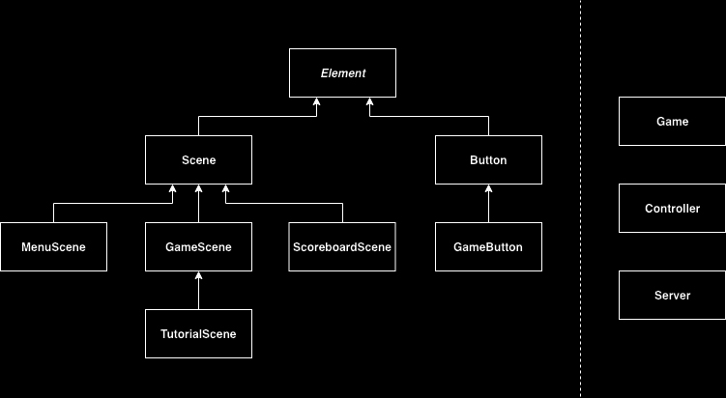
SIMPLIFIED UML DIAGRAM

Slide 4
EXAMPLE: GAME CLASS

Slide 5
QUESTIONS

